Slide 1
CE103 Algorithms and Programming I
Introduction to Code Reusability and Automate Testing Author: Asst. Prof. Dr. Uğur CORUH

Slide 2
CE103 Algorithms and Programming I
Week-4
Fall Semester, 2021-2022
Download DOC, SLIDE, PPTX

Slide 3
Introduction to Code Reusability and Automated Testing
During this course we will use entry level of shared library development and their tests and test automations. Also we will see TDD(Test Driven Development) approach.

Slide 4
During this course we will use Windows OS, Eclipse and Visual Studio Commuity Edition environments for examples.

Slide 5
Each example will include two function
“Hello ” printing function with name sayHelloTo(name) and
sum of two variable function for basic, sum = sum(a,b).
This sum function will add a to b and return result to sum variable.
We will locate them in library and use them from a console application, also we will create unit tests for testing their functionalities and return variables

Slide 6
Shared Library Development
C Programming (Static Library)
Visual Studio Community Edition
In this sample we will create c-lib-sample project that contains library, executable, unit tests and unit test runners.

Slide 7
First of all you install Visual Studio Community Edition from website
Visual Studio 2019 Community Edition - Son Ücretsiz Sürümü İndir

Slide 8
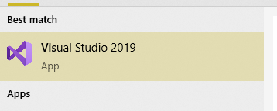
Open visual studio community edition and select create a new project
height:300px

Slide 9

height:500px

Slide 10
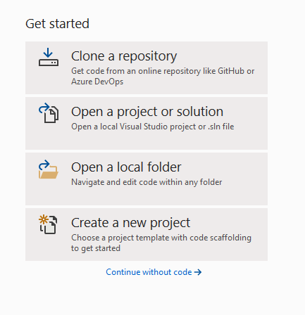
Select create a new project
height:500px

Slide 11
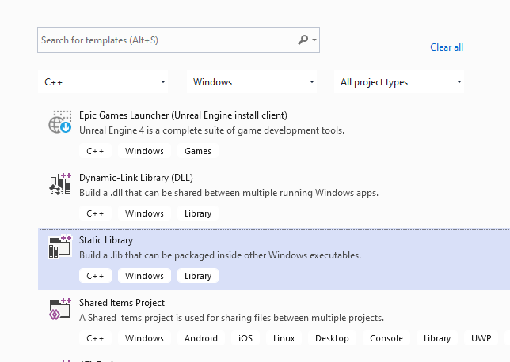
Select C++ static library from project list
height:500px

Slide 12
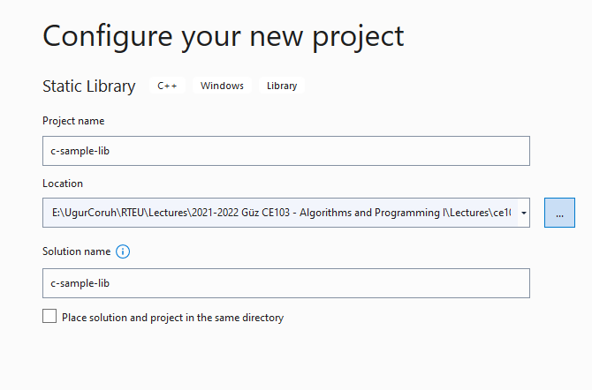
Name static library project
height:500px

Slide 13
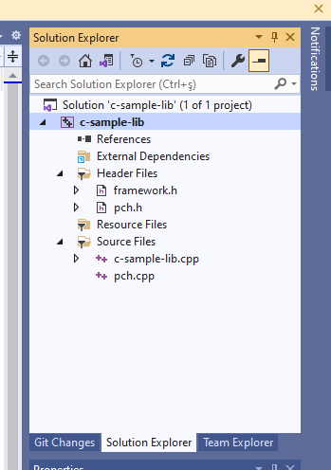
Default configuration come with C++ project types and setting
height:500px

Slide 14
In the c-sample-lib.cpp you will sample function
void fncsamplelib() { }

Slide 15
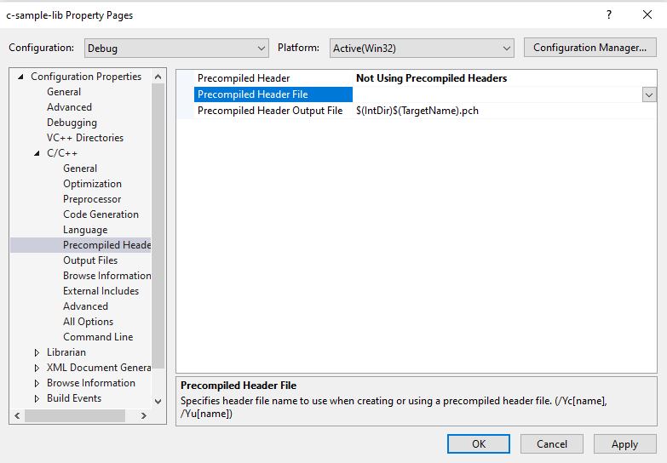
Delete pch.h and pch.c files. Also disable use precompiled header settings from configurations and change to “Not Using Precomplied Headers”, also you can delete precomplied Header File.
height:400px

Slide 16
Customize library header name and update “framework.h” to “samplelib.h”
Insert your functions inside the c-sample-lib.c and update header files also.
// c-sample-lib.cpp : Defines the functions for the static library. // #include "samplelib.h" #include "stdio.h" /// <summary> /// /// </summary> /// <param name="name"></param> void sayHelloTo(char* name){ if (name != NULL){ printf("Hello %s \n",name); } else { printf("Hello There\n"); } } /// <summary> /// /// </summary> /// <param name="a"></param> /// <param name="b"></param> /// <returns></returns> int sum(int a, int b){ int c = 0; c = a + b; return c; }

Slide 17
also update samplelib.h
#pragma once #define WIN32_LEAN_AND_MEAN // Exclude rarely-used stuff from Windows headers void sayHelloTo(char* name); int sum(int a, int b);

Slide 18
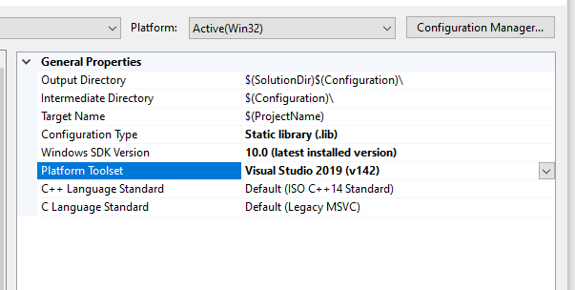
If you check configuration you will see that for C complier we are using Microsoft Environment and Toolkits
height:500px

Slide 19
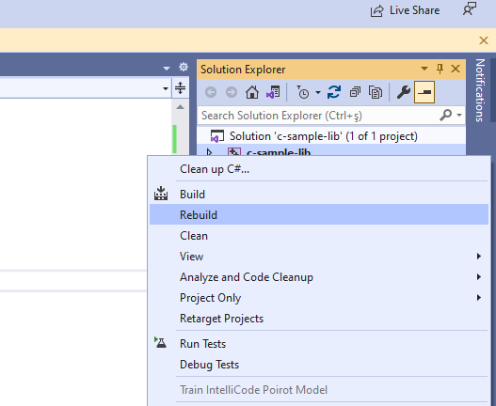
Now we can compile our library
height:500px

Slide 20
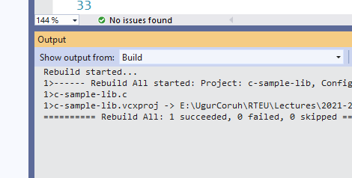
You can follow operation from output window
height:500px

Slide 21
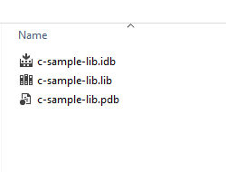
in debug folder we will see our output
height:500px

Slide 22
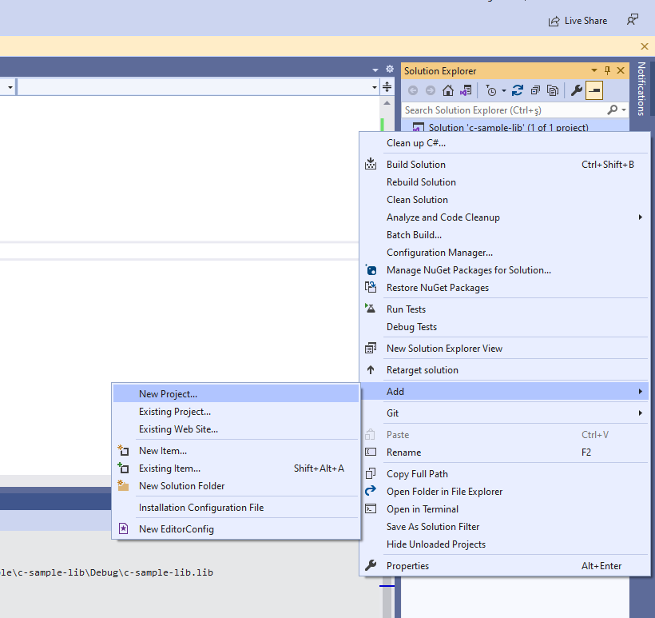
now we will add a console application c-sample-app and use our library
height:500px

Slide 23
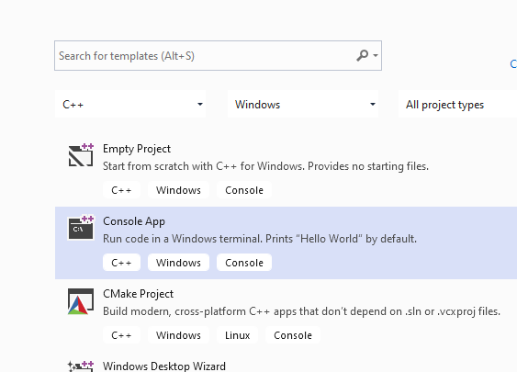
select C++ Windows Console Application from list
height:500px

Slide 24
C++ Console Application Selection will generate a C++ console project we can change extension to C to compile our application as C application.
we will convert c-sample-app.c to following code
#include <stdio.h> /// <summary> /// /// </summary> /// <returns></returns> int main() { printf("Hello World!\n"); }

Slide 25
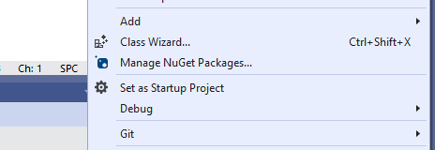
after conversion set c-sample-app as startup project and build it
height:150px

Slide 26
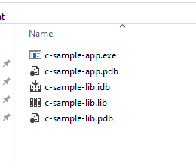
this will create c-sample-app.exe in the same folder with c-sample-lib.lib library
height:300px

Slide 27
if we run application we will see only “Hello World”

Slide 28
now we will see two options to add library as references in our application and use its functions.

Slide 29
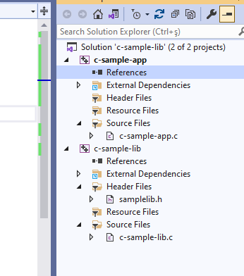
First option
right click references for c-sample-app and add current library as reference
height:500px

Slide 30
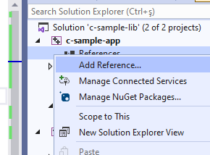
Select Add Reference
height:500px

Slide 31
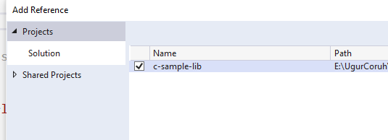
Browse for solution and select c-sample-lib
height:500px

Slide 32
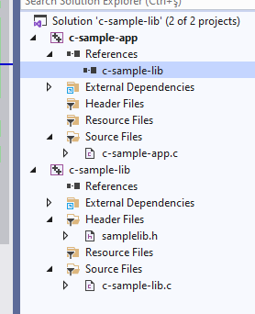
You can check added reference from references section
height:500px

Slide 33
now we can include required headers from c-sample-lib folder and use it.
we can include required header with relative path as follow or with configuration
#include <stdio.h> #include "..\c-sample-lib\samplelib.h" /// <summary> /// /// </summary> /// <returns></returns> int main() { printf("Hello World!\n"); }

Slide 34
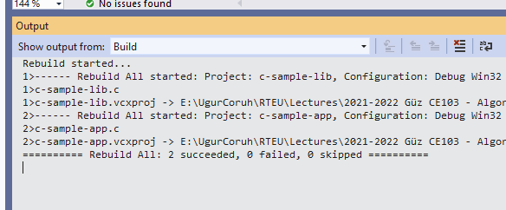
we can build our c-sample-app
height:500px

Slide 35
also we can only write header name
#include <samplelib.h>

Slide 36
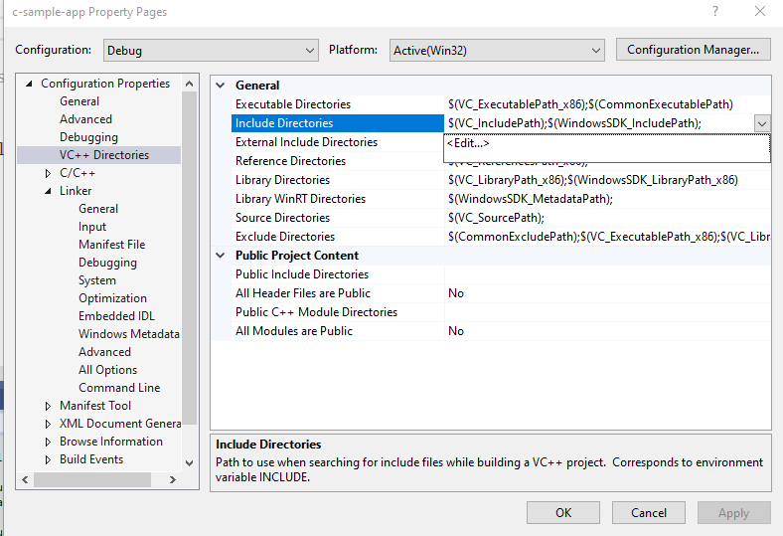
for this we need to configure include directories
height:500px

Slide 37
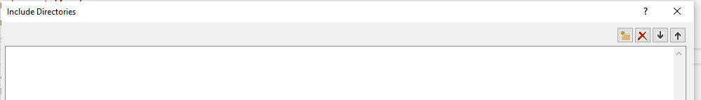
select c-sample-lib header file location
height:100px

Slide 38
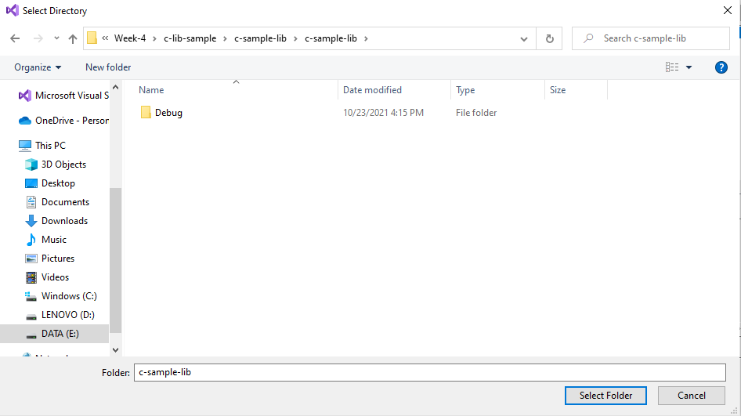
browse for folder
height:300px

Slide 39
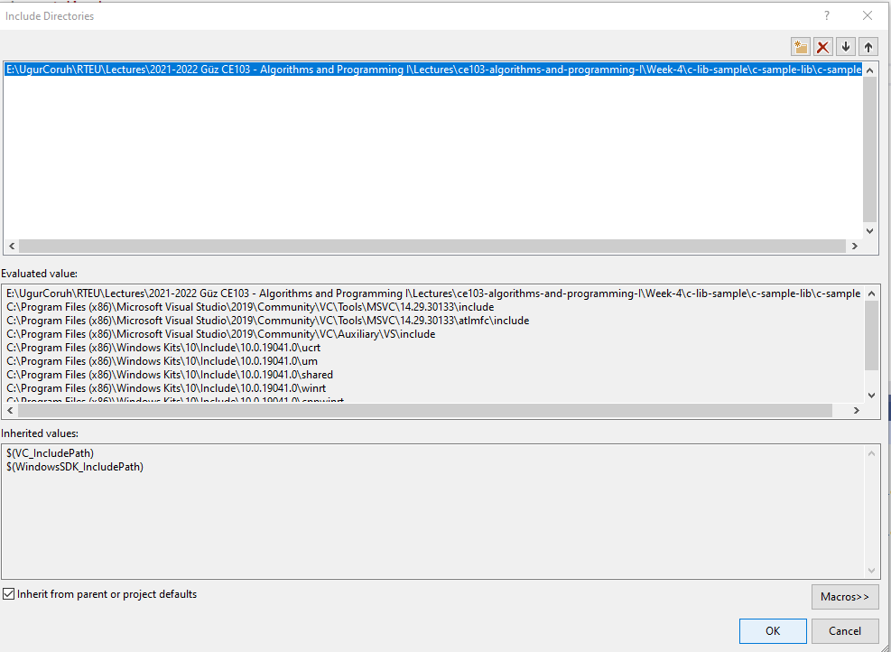
your full path will be added to your configuration
height:500px

Slide 40
if you add header file paths to your configuration you can use header files by name in your source code
#include <stdio.h> #include <samplelib.h> /// <summary> /// /// </summary> /// <returns></returns> int main() { printf("Hello World!\n"); }

Slide 41
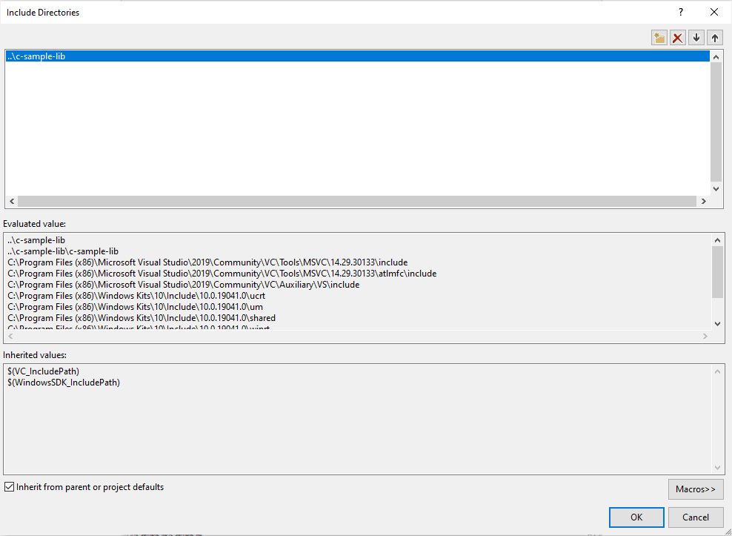
we can compile the following we don’t have problems but here we need to configure relative paths for configuration open include library settings and update with relative path
..\c-sample-lib
height:400px

Slide 42
now we have portable source code configuration. we can call our functions and then we can update header and library folder configurations.
#include <stdio.h> #include <samplelib.h> /// <summary> /// /// </summary> /// <returns></returns> int main() { int result = 0; //printf("Hello World!\n"); result = sum(5, 4); sayHelloTo("Computer"); printf("Result is %d \n",result); printf("Press any key to continue...\n"); getchar(); return 0; }

Slide 43
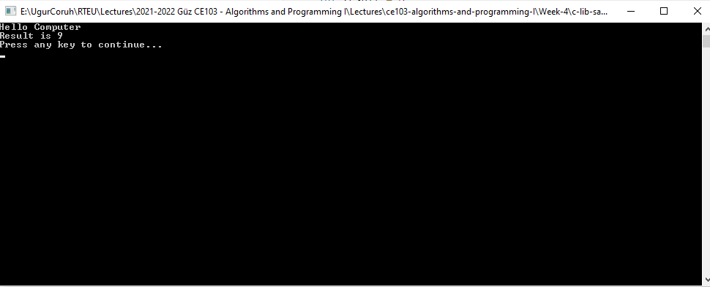
when you run you will see the following outputs, that mean we called library functions.
height:400px

Slide 44
static library is a code sharing approach if you want to share your source code with your customers then you can share static libraries and header files together. Another case you can use a precompiled static library with you or this library can be part of any installation then if there is a installed app and static libraries are placed on system folder or any different location then you can use configuration files to set library path and included header paths

Slide 45
Now we can remove project from c-sample-app references but we will set library file in configuration
Before this copy static library and header files to a folder like that
DebugStaticLibDeployment
Set C/C++ -> General -> Additional Include Directories
There is a bug in configurations and relative path not finding headers so for this reason we will set full path but this is not a good practice for team working

Slide 46
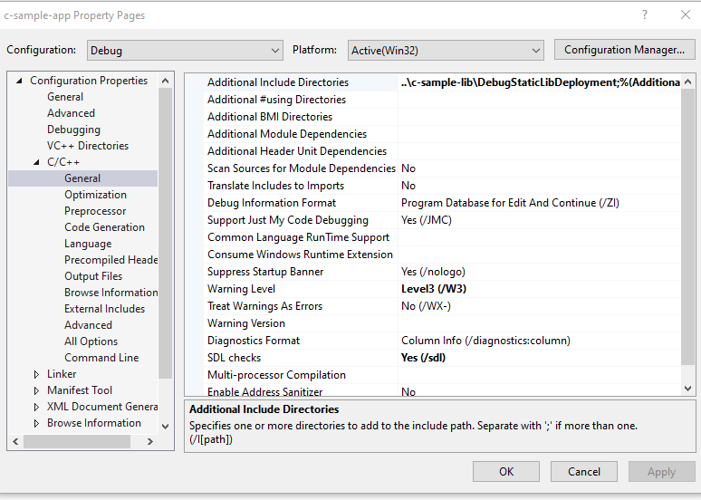
Not Working
..\c-sample-lib\DebugStaticLibDeployment
height:400px

Slide 47
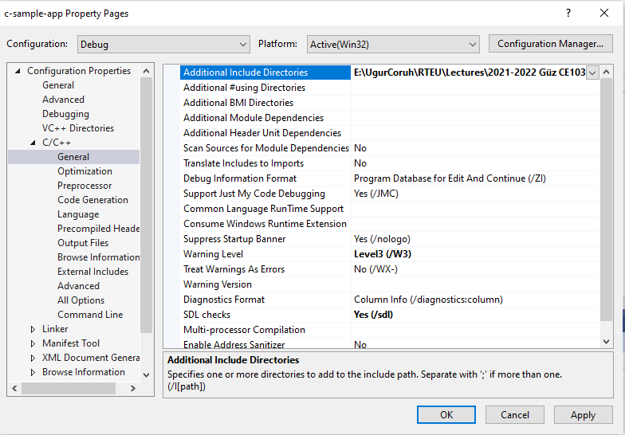
Working
E:\...\c-lib-sample\c-sample-lib\DebugStaticLibDeployment
height:400px

Slide 48
Now we will set library folder that our static library placed
we will set VC++ Directories -> Library Directories
Here is the same issue if we use relative path it doesn’t work we need to set full path for library folder

Slide 49
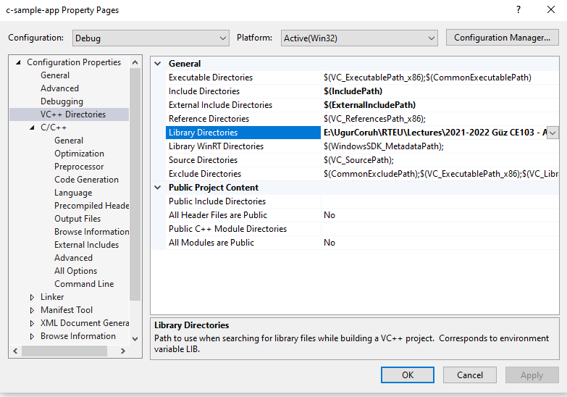
Working
E:\...\c-lib-sample\c-sample-lib\DebugStaticLibDeployment
height:500px

Slide 50
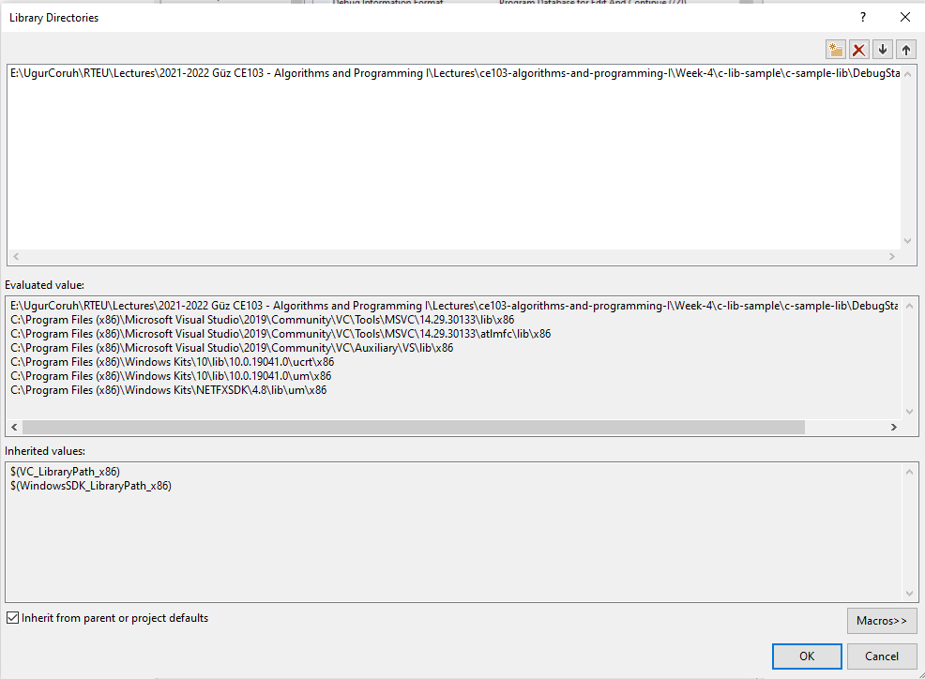
height:500px

Slide 51
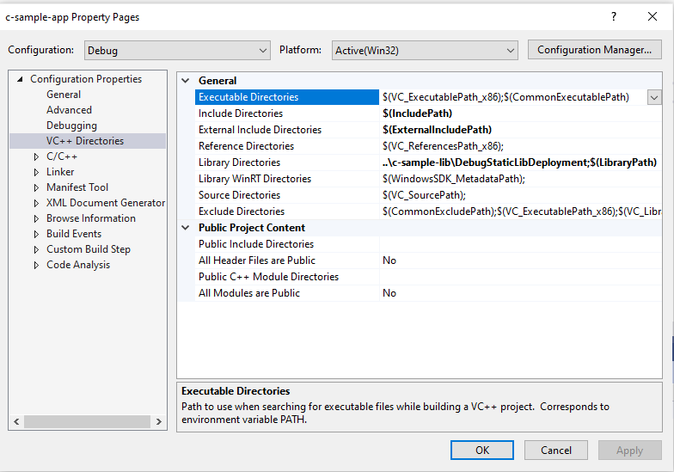
Not Working
..\c-sample-lib\DebugStaticLibDeployment
height:500px

Slide 52
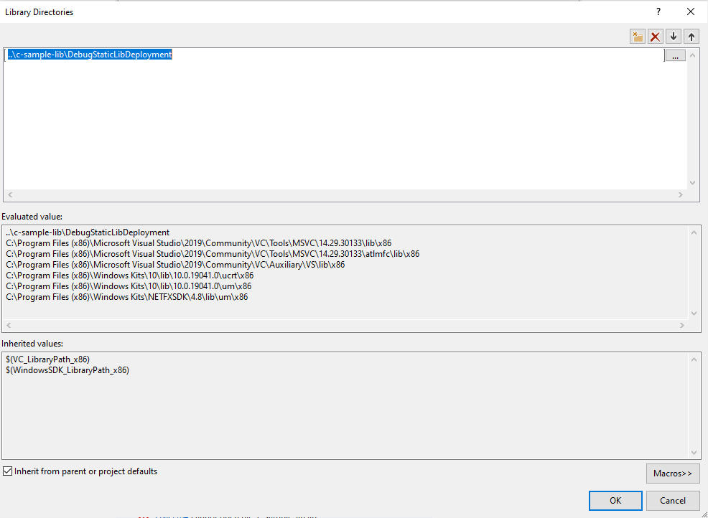
height:400px

Slide 53
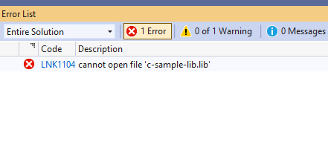
height:150px

Slide 54
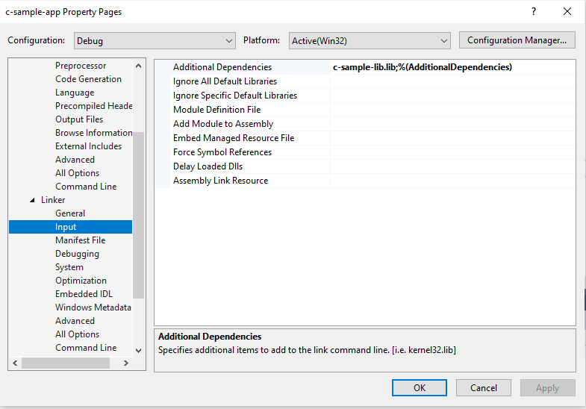
If we set full path for both libraries and headers then we need to set library name for project
Linker->Input->Additional Dependencies
height:350px

Slide 55
In this case we will compile c-sample-app and we do not need to compile c-sample-lib because we copied output files to different location and they are ready to use.

Slide 56
current source code will be like that nothing changed
#include <stdio.h> #include <samplelib.h> /// <summary> /// /// </summary> /// <returns></returns> int main() { int result = 0; //printf("Hello World!\n"); result = sum(5, 4); sayHelloTo("Computer"); printf("Result is %d \n",result); printf("Press any key to continue...\n"); getchar(); return 0; }

Slide 57
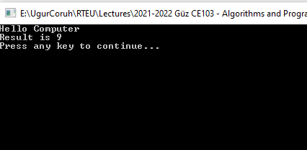
and output
height:400px

Slide 58
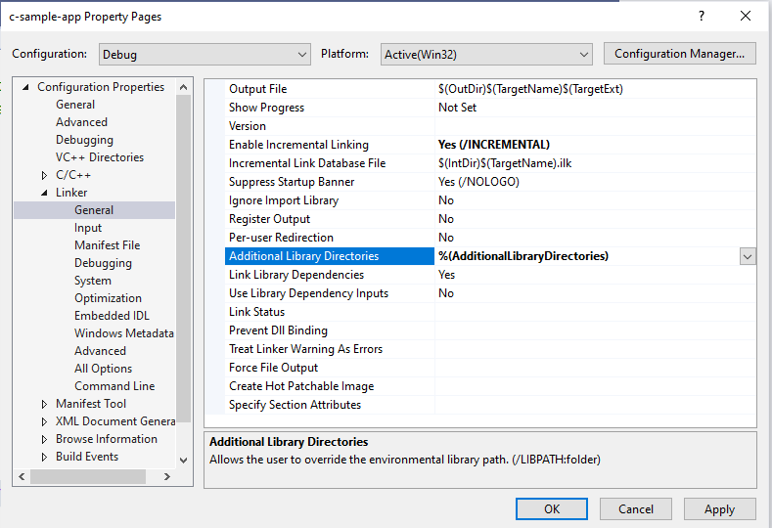
There is a option about portability that we can set for team works
We will remove all library related settings from configurations and we will write them in source code
Clear linker->general->additional library directories
height:400px

Slide 59
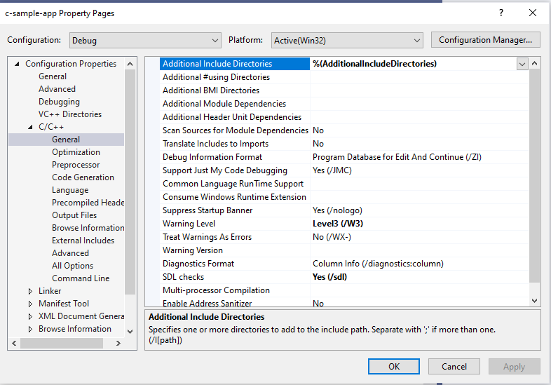
Clear C/C++ -> General -> Additional Include Directories
height:400px

Slide 60
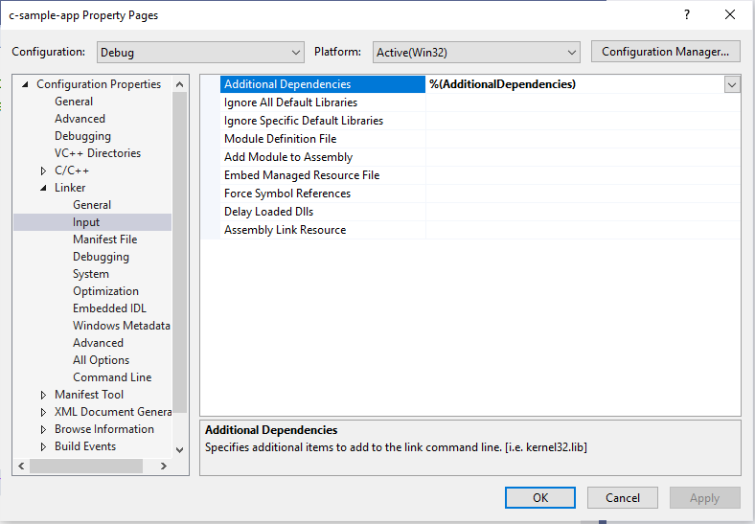
Clear Linker->Input->Additional Dependencies
height:400px

Slide 61
Now we can set this configurations in source code as follow
#pragma comment(lib, "..\\DebugStaticLibDeployment\\c-sample-lib.lib") #include "..\DebugStaticLibDeployment\samplelib.h" #include <stdio.h> /// <summary> /// /// </summary> /// <returns></returns> int main() { int result = 0; //printf("Hello World!\n"); result = sum(5, 4); sayHelloTo("Computer"); printf("Result is %d \n",result); printf("Press any key to continue...\n"); getchar(); return 0; }
with this configuration if your friends download this code then they can run them with their environment without setting a path.

Slide 62
C++ Programming (Static Library)

Slide 63
Visual Studio Community Edition
All steps are similar with C programming above, but you do not need to delete pch.h
You should take care about compiled source codes
for example if your code is compiled for x86 then your application also should use the x86 configuration else x64 then library should be x64 complied version.

Slide 64
Source will look like the following
// cpp-sample-app.cpp : This file contains the 'main' function. Program execution begins and ends there. // #pragma comment(lib, "..\\DebugStaticLibDeployment\\cpp-sample-lib.lib") #include "..\DebugStaticLibDeployment\samplelib.h" #include <iostream> int main() { std::cout << "Hello World!\n"; int result = 0; //printf("Hello World!\n"); result = sum(5, 4); sayHelloTo("Computer"); printf("Result is %d \n", result); printf("Press any key to continue...\n"); getchar(); return 0; }

Slide 65
C/C++ WSL Option

Slide 66
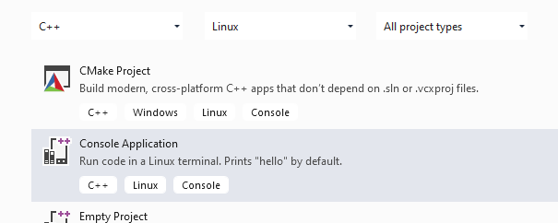
Install WSL
GitHub - ucoruh/ns3-wsl-win10-setup: ns3 windows 10 WSL2 setup and usage
Create a Linux project
height:500px

Slide 67
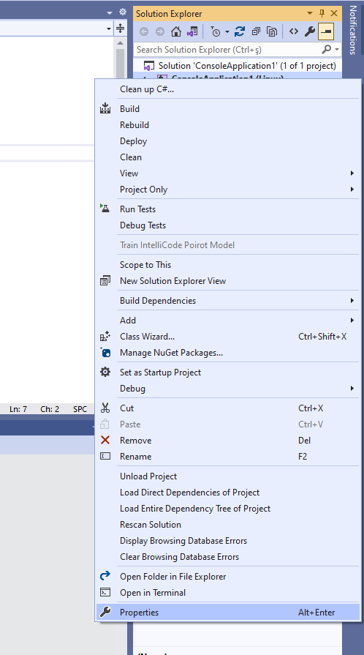
Configure Platform Toolset to WSL
height:500px

Slide 68
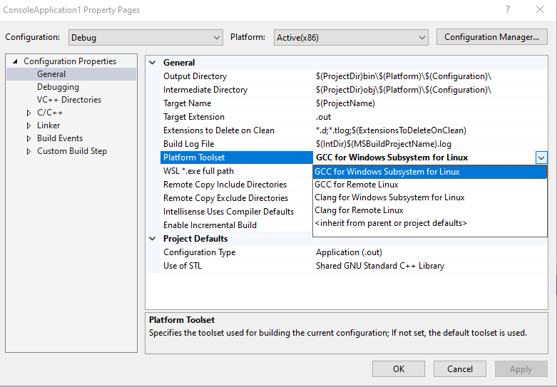
Select GCC for Windows Subsystem for Linux
height:400px

Slide 69
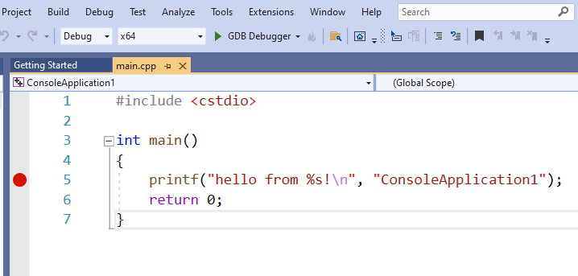
Put a breakpoint and run debugger
height:400px

Slide 70
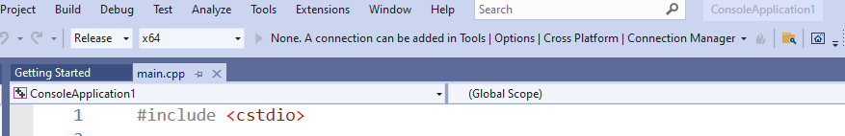
In the debugger for WSL you can use local WSL installation but if you want to run it on Release setting it require a SSH connection.
height:200px

Slide 71
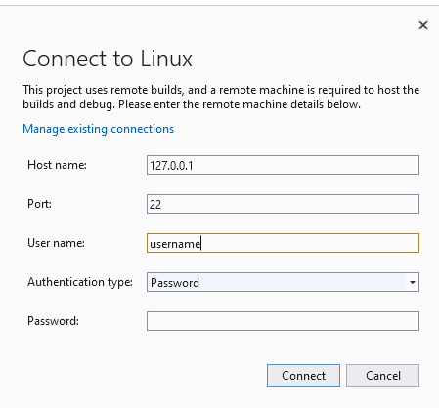
Configure SSH parameters
height:400px

Slide 72
so you have to complete the following steps.
C/C++ Remote Linux Option over SSH
Enable SSH
SSH on Windows Subsystem for Linux (WSL) | Illuminia Studios
Connect to Remote WSL Environment
Bağlan hedef Linux sisteminize Visual Studio | Microsoft Docs

Slide 73
C# Programming (Dinamik Library)

Slide 74
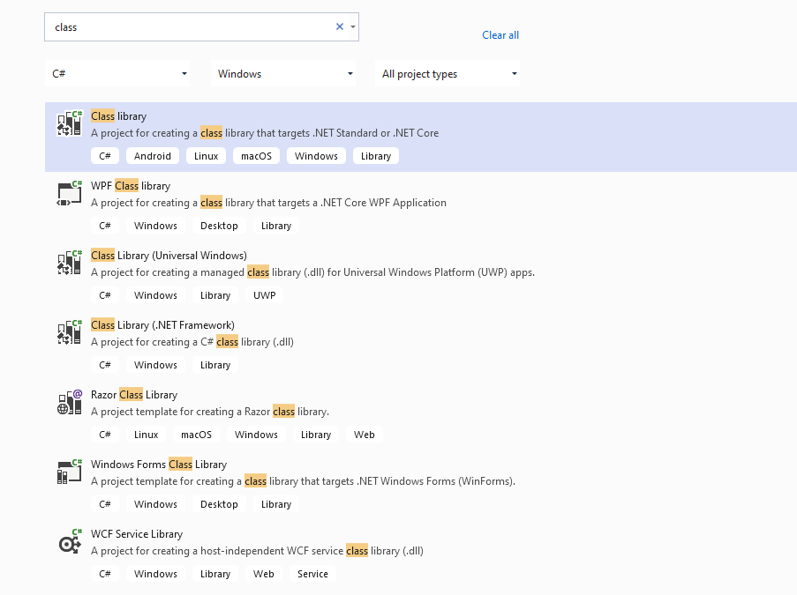
Visual Studio Community Edition
In C# project we will create class library we have several options
for this sample we will select .NET core that we can build cross platform library
height:400px

Slide 75
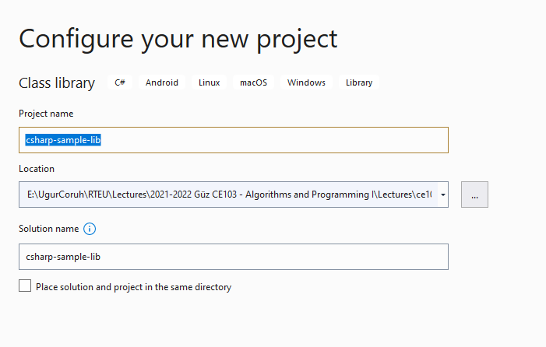
There is no static library option

Slide 76
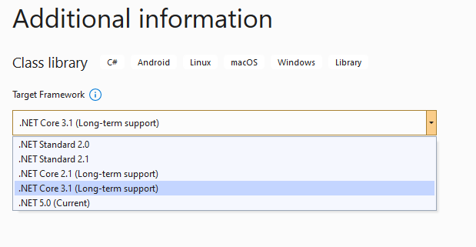
We will select .Net Core 3.1
height:400px

Slide 77
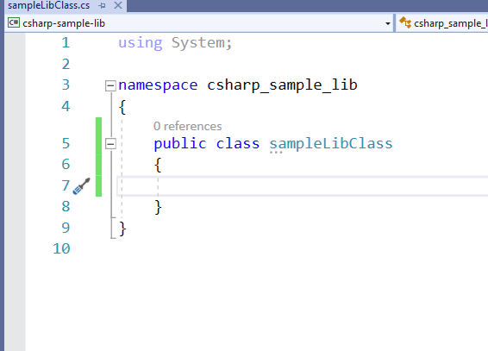
You will have default empty class library file
height:400px

Slide 78
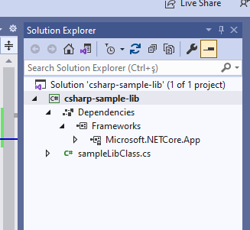
In the project you can see .NETcore reference
height:400px

Slide 79
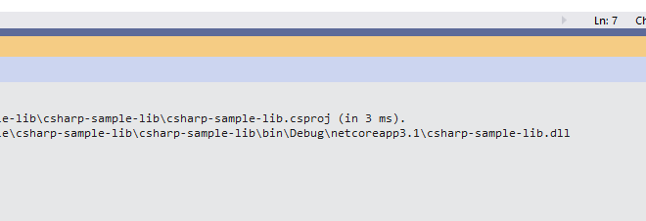
We can build empty class library that generate dll for our application
height:400px

Slide 80
Now we will add Console Application but this will also use .NETCore

Slide 81
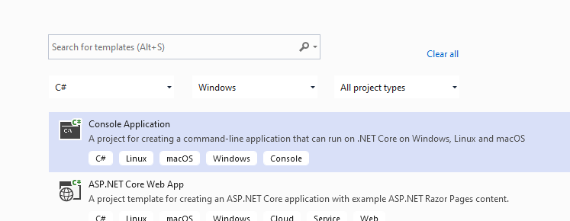
Select New Project
height:400px

Slide 82

Name the project
height:400px

Slide 83

Select .NETCore framework
height:400px

Slide 84
You will have the following sample main.cs file
using System; namespace csharp_sample_app { class Program { static void Main(string[] args) { Console.WriteLine("Hello World!"); } } }

Slide 85

Now we can link projects with adding references open reference section
height:400px

Slide 86

browse for class library project output folder and select output dll file for console application
height:400px

Slide 87
now we can update our library code and use it in console application
copy following sample to sampleLibClass file in the library
using System; namespace csharp_sample_lib { public class sampleLibClass { public static void sayHelloTo(string name) { if (!String.IsNullOrEmpty(name)) { Console.WriteLine("Hello " + name); } else { Console.WriteLine("Hello There"); } } public static int sum(int a, int b) { int c = 0; c = a + b; return c; } } }

Slide 88
after this operation copy following sample to console application and build app then you can run
using csharp_sample_lib; using System; namespace csharp_sample_app { class Program { static void Main(string[] args) { Console.WriteLine("Hello World!"); sampleLibClass.sayHelloTo("Computer"); int result = sampleLibClass.sum(5, 4); Console.WriteLine("Results is" + result); Console.WriteLine("Results is {0}", result); Console.Read(); } } }

Slide 89

You will see following output that mean we called DLL functions
height:400px

Slide 90
Also we can publish this console application with dll for linux environment or others
for linux environment we should install .NETCore

Slide 91
follow the link below or commands that I shared with you as below for deployment
How to Install Dotnet Core on Ubuntu 20.04 – TecAdmin
Step 1 – Enable Microsoft PPA
wget https://packages.microsoft.com/config/ubuntu/20.04/packages-microsoft-prod.deb sudo dpkg -i packages-microsoft-prod.deb

Slide 92
Step 2 – Installing Dotnet Core SDK
sudo apt update sudo apt install apt-transport-https sudo apt install dotnet-sdk-3.1

Slide 93
Step 3 – Install Dotnet Core Runtime Only
To install .NET Core Runtime on Ubuntu 20.04 LTS system, execute the commands:
sudo apt update

Slide 94
To install the previous version of .Net core runtime 2.1, type:
sudo apt install dotnet-runtime-2.1
Press “y” for any input prompted by the installer.

Slide 95

Step 4 – (Optional) Check .NET Core Version
You can use dotnet command line utility to check installed version of .NET Core on your system. To check dotnet version, type:
dotnet --version
height:200px

Slide 96

Now we will publish our application as single executable
Open publish menu
height:400px

Slide 97

Select netcoreapp3.1 and Release for linux-x64
height:400px

Slide 98

Select produce single file
height:400px

Slide 99

After succesfull publish you will have linux binary that you can run with WSL
height:400px

Slide 100

Open WSL and enter the path where this folder located
and run application as follow

Slide 101

check dotnet –version and then run application

Slide 102

you will see similar output

Slide 103

In this sample we created single application from settings lets try with shared library located option uncheck the “produce single file” option and publish again.
Then you will have the following outputs
height:400px

Slide 104

If you run csharp-sample-app
you will have the same output
height:300px

Slide 105
Java Programming

Slide 106

Eclipse IDE
You should download and install eclipse installer and then you should select Eclipse IDE for Java Developers
Eclipse Installer 2021-09 R | Eclipse Packages
height:400px

Slide 107

height:500px

Slide 108

height:500px

Slide 109


Slide 110

select create a project
height:500px

Slide 111

select java project
height:500px

Slide 112

give project name
height:500px

Slide 113

select finish
height:500px

Slide 114

first we need to add a default package to keep everything organized
height:500px

Slide 115

then we can create our class that includes our functions
height:500px

Slide 116

give class a name
height:500px

Slide 117

you will have following class with main
height:500px

Slide 118
We will create sample java library with static functions as below.
package ce103; import java.io.IOException; public class JavaSampleLib { public static void sayHelloTo(String name) { if(name.isBlank() || name.isEmpty()) { System.out.println("Hello "+name); }else { System.out.println("Hello There"); } } public static int sum(int a,int b) { int c = 0; c = a+b; return c; } public static void main(String[] args) { // TODO Auto-generated method stub System.out.println("Hello World!"); JavaSampleLib.sayHelloTo("Computer"); int result = JavaSampleLib.sum(5, 4); System.out.println("Results is" + result); System.out.printf("Results is %d \n", result); try { System.in.read(); } catch (IOException e) { // TODO Auto-generated catch block e.printStackTrace(); } } }

Slide 119

also we can add main method to run our library functions. If we run this file its process main function
height:500px

Slide 120

we can see output from console as below
height:500px

Slide 121

There is no exe files java runtime environment run class files but we can export this as an executable.
height:500px

Slide 122

Select Java->Runnable JAR File
height:500px

Slide 123

click next and set output path for jar file
height:500px

Slide 124

If our project has several external dependecy then we can extract this required files (jar, so, dll) in seperated folder or we can combine them and generate a single executable jar
Lets pack everthing together, Select launch configuration that has main function
height:500px

Slide 125

end of this operation we will have the following jar that we can by click
height:500px

Slide 126

When you click application if cannot run then try command line to see problem
enter jar folder and run the following command
java -jar JavaSampleLibExecutable.jar
height:200px

Slide 127

In my case eclipse build JDK is newer than that I installed and set for my OS
If we check version we can see problem Java version 1.8.0_231
height:100px

Slide 128

We can found installed and builded JDK for our application from Eclipse setting
height:500px

Slide 129

select environments
height:500px

Slide 130

select installed JRE or JDK
height:500px

Slide 131

you can see installed JRE or JDK home
C:\Program Files\Java\jdk-16.0.1
height:400px

Slide 132

Open system environment to fix this problem
height:500px

Slide 133

height:500px

Slide 134

Check user settings first
height:500px

Slide 135

height:500px

Slide 136

Check system settings
height:500px

Slide 137

height:500px

Slide 138

we will move up the JDK 16 configuration then command line will run first java
height:500px

Slide 139

Also in system setting check JAVA_HOME
height:500px

Slide 140

After this settings close current command line and open new one
write
java --version
if you see java version updated and 16.0.1 then settings are correct
height:500px

Slide 141

and now if we enter and run application as follow we will see output
height:500px

Slide 142

But when you click this jar its not running as you see so we have options to provide a clickable application there
Launch4j is an option here
Launch4j - Cross-platform Java executable wrapper
How to use Launch4

Slide 143
you can watch this tutorial also
How to convert jar to exe using Launch4J Full explanation - YouTube

Slide 144

Download and install launch4j and open application
height:200px

Slide 145

configure your application settings similar to below select jar file and exe output path
height:500px

Slide 146

we can customize main class if have multiple main class
height:500px

Slide 147

select console from setting for this application
height:500px

Slide 148

we can provide a single running application, this setting avoid to run multiple instances
height:500px

Slide 149

we need to set runtime environment versions
height:500px

Slide 150

you can set system parameters before running application
height:500px

Slide 151

with splash screen you can show a splash screen image for your application
height:500px

Slide 152

File attributes such as version product information is configured from version info tab
height:500px

Slide 153

if your application runtime condition has an error then you can show this customized messages also
height:500px

Slide 154

with this options save configuration file xml
height:500px

Slide 155

and compile settings
height:500px

Slide 156
you will see generated output file in log screen
Compiling resources Linking Wrapping WARNING: Sign the executable to minimize antivirus false positives or use launching instead of wrapping. Successfully created C:\Users\ugur.coruh\Desktop\java-export-sample\JavaSampleLibExecutable.exe

Slide 157

now we can run exe by click
height:300px

Slide 158

height:200px

Slide 159
another option here adding a bat file to run current jar file

Slide 160

JavaSampleLibExecutable.bat
java -jar JavaSampleLibExecutable.jar
height:200px

Slide 161

if we click bat file then we will automate command line task for current jar file
height:200px

Slide 162

Now return back to our java library and create another console application that use library functions
height:500px

Slide 163

height:500px

Slide 164

height:500px

Slide 165

you can set libraries in this step from but our library should exported for our solution
height:500px

Slide 166

Select Add External JARs…
height:200px

Slide 167

Open Exported jar folder and select
height:500px

Slide 168

Or we can select by Add jar from current workspace
height:200px

Slide 169

height:200px

Slide 170

but in this step I won’t add anything I’ll add references later
height:500px

Slide 171

we will have the following project
height:500px

Slide 172

lets create a package
height:500px

Slide 173

height:500px

Slide 174

and lets create a main class for our application
height:500px

Slide 175

check create main function
height:500px

Slide 176

height:500px

Slide 177

right click to project and add reference
height:500px

Slide 178

you can enter same configurations from project properties
height:500px

Slide 179

Lets export our library as a JAR file and then add to our classpath
height:500px

Slide 180

Select JAR file
height:500px

Slide 181

we configured output as
C:\Users\ugur.coruh\Desktop\java-export-sample\JavaSampleLib.jar
height:500px

Slide 182

height:500px

Slide 183

height:500px

Slide 184

In the same export folder now we have JavaSampleLib.jar
height:500px

Slide 185

return back to java-sample-app and then add this jar file to our project
Build Path->Add External Archives
height:500px

Slide 186

you will see its added to reference libraries
height:500px

Slide 187
in our JavaSampleApp.java we can use the following source codes
package ce103; import java.io.IOException; public class JavaSampleApp { public static void main(String[] args) { // TODO Auto-generated method stub System.out.println("Hello World!"); JavaSampleLib.sayHelloTo("Computer"); int result = JavaSampleLib.sum(5, 4); System.out.println("Results is" + result); System.out.printf("Results is %d \n", result); try { System.in.read(); } catch (IOException e) { // TODO Auto-generated catch block e.printStackTrace(); } } }

Slide 188

When we run application we will see similar output
height:500px

Slide 189

Lets export this application with its dependent library
height:500px

Slide 190

Select runnable jar
height:500px

Slide 191

Set Launch configuration and Export destination
C:\Users\ugur.coruh\Desktop\java-export-sample\JavaSampleAppSingle.jar
height:500px

Slide 192

In this option we will have single jar file
In the export folder we do not see reference libraries
height:200px

Slide 193

and we can run with command line
height:200px

Slide 194

only change copy required libraries setting and then give a new name for new jar file and export
C:\Users\ugur.coruh\Desktop\java-export-sample\JavaSampleAppMultiple.jar
height:500px

Slide 195

now we have a folder that contains our libraries referenced
height:500px

Slide 196

in this file we can find our library
height:500px

Slide 197

if we test our application we will see it will work
height:200px

Slide 198

if we delete JavaSampleLib.jar and then try running application we will get error
height:200px

Slide 199
Program Testing

Slide 200
Unit Test Development

Slide 201
C Unit Tests

Slide 202
Visual Studio Community Edition

Slide 203
C++ Unit Tests

Slide 204

Visual Studio Community Edition
C/C++ için birim testleri yazma - Visual Studio (Windows) | Microsoft Docs
Use cpp-sample-lib project and add
height:500px

Slide 205

select Native Unit Test
height:500px

Slide 206

set project path and name
height:500px

Slide 207

you will have cpp-sample-test project
height:500px

Slide 208

add library project from references
height:500px

Slide 209

Add cpp-sample-lib to cpp-sample-test project
height:500px

Slide 210
cpp-sample-test.cpp
#include "pch.h" #include "CppUnitTest.h" #include "..\cpp-sample-lib\samplelib.h" using namespace Microsoft::VisualStudio::CppUnitTestFramework; namespace cppsampletest { TEST_CLASS(cppsampletest) { public: TEST_METHOD(TestSumCorrect) { Assert::AreEqual(9, sum(4, 5)); } TEST_METHOD(TestSumInCorrect) { Assert::AreEqual(10, sum(4, 5)); } }; }

Slide 211

height:500px

Slide 212
C# Unit Tests

Slide 213

Visual Studio Community Edition (MSTestV2+.Net)
Install extension fine code coverage
https://marketplace.visualstudio.com/items?itemName=FortuneNgwenya.FineCodeCoverage
Create a .Net Framework Library
height:500px

Slide 214

set project framework and path
height:500px

Slide 215

Create library functions
height:500px

Slide 216
using System; using System.Collections.Generic; using System.Text; namespace cs_lib_sample { public class SampleLibClass { public static string sayHelloTo(string name) { string result = String.Empty; if (!String.IsNullOrEmpty(name)) { result = "Hello " + name; } else { result = "Hello There"; } Console.WriteLine(result); return result; } public static int sum(int a, int b) { int c = 0; c = a + b; return c; } public int multiply(int a, int b) { return a * b; } } }

Slide 217

right click and then create unit test project
height:500px

Slide 218

press OK
height:500px

Slide 219
enter test code
using Microsoft.VisualStudio.TestTools.UnitTesting; using cs_lib_sample; using System; using System.Collections.Generic; using System.Linq; using System.Text; using System.Threading.Tasks; namespace cs_lib_sample.Tests { [TestClass()] public class SampleLibClassTests { [TestMethod()] public void testSayHelloTo() { Assert.AreEqual("Hello Computer", SampleLibClass.sayHelloTo("Computer"), "Regular say hello should work"); } [TestMethod()] public void testSayHelloToWrong() { Assert.AreEqual("Hello All", SampleLibClass.sayHelloTo("Computer"), "Regular say hello won't work"); } [TestMethod()] public void testSumCorrect() { Assert.AreEqual(9, SampleLibClass.sum(4, 5), "Regular sum should work"); } [TestMethod()] public void testSumWrong() { Assert.AreEqual(10, SampleLibClass.sum(4, 5), "Regular sum shouldn't work"); } [TestMethod()] public void testMultiply() { SampleLibClass sampleLib = new SampleLibClass(); Assert.AreEqual(20, sampleLib.multiply(4, 5), "Regular multiplication should work"); } } }

Slide 220

Run tests
height:500px

Slide 221

you will code coverage and entered or passed branches
height:500px

Slide 222

Visual Studio Community Edition (NUnit+.NETCore)
use cshar-sample-lib for this example
create and add a unit test project to solution
height:500px

Slide 223

height:500px

Slide 224

height:500px

Slide 225

height:500px

Slide 226

Add project reference
height:500px

Slide 227

height:500px

Slide 228
SampleLibraryTestClasss in NUnit Project
using csharp_sample_lib; using NUnit.Framework; namespace csharp_sample_lib_test { public class SampleLibraryTestClass { sampleLibClass sampleLib; [SetUp] public void Setup() { sampleLib = new sampleLibClass(); } [Test] public void testSayHelloTo() { Assert.AreEqual("Hello Computer", sampleLibClass.sayHelloTo("Computer"), "Regular say hello should work"); } [Test] public void testSayHelloToWrong() { Assert.AreEqual("Hello All", sampleLibClass.sayHelloTo("Computer"), "Regular say hello won't work"); } [Test] public void testSumCorrect() { Assert.AreEqual(9, sampleLibClass.sum(4, 5), "Regular sum should work"); } [Test] public void testSumWrong() { Assert.AreEqual(10, sampleLibClass.sum(4, 5), "Regular sum shouldn't work"); } [Test] public void testMultiply() { Assert.AreEqual(20, sampleLib.multiply(4, 5), "Regular multiplication should work"); } } }

Slide 229
sample class library
using System; namespace csharp_sample_lib { public class sampleLibClass { public static string sayHelloTo(string name) { string result = String.Empty; if (!String.IsNullOrEmpty(name)) { result = "Hello " + name; } else { result = "Hello There"; } Console.WriteLine(result); return result; } public static int sum(int a, int b) { int c = 0; c = a + b; return c; } public int multiply(int a, int b) { return a * b; } } }

Slide 230

Open test explorer and run tests
height:500px

Slide 231

or you can run from project
height:500px

Slide 232

Also we can create unit test from library class,
right click the sampleLibClass and select create unit tests but this option do not provide nunit tests.
height:500px

Slide 233

height:500px

Slide 234

height:500px

Slide 235

height:500px

Slide 236
using Microsoft.VisualStudio.TestTools.UnitTesting; using csharp_sample_lib; using System; using System.Collections.Generic; using System.Text; namespace csharp_sample_lib.Tests { [TestClass()] public class sampleLibClassTests { [TestMethod()] public void sayHelloToTest() { Assert.Fail(); } [TestMethod()] public void sumTest() { Assert.Fail(); } [TestMethod()] public void multiplyTest() { Assert.Fail(); } } }

Slide 237

we will not commit this changes and continue from nunit test project, the fine code
coverage also work for nunit test but not provide inline highlighting
if we run tests we will have the following outputs
height:500px

Slide 238

height:500px

Slide 239
Inline code highlight is part of enterprise visual studio edition
Analyzing code coverage in Visual Studio - DEV Community

Slide 240
TL;DR
Additional information you can use OpenCover + Nunit Runner + Report Generator together to setup a code coverage report but it has complex batch running process. After a few try I decided to use fine code coverage but here is the usage not tested well.
First unit test runner tool doesn’t support .Net Core
c# - The NUnit 3 driver encountered an error while executing reflected code (NUnit.Engine.NUnitEngineException) - Stack Overflow
Follow the instructions on the link
CMD OpenCover · sukhoi1/Useful-Notes Wiki · GitHub
Install OpenCover, ReportGenerator, Nunit,Runners packages then use the package installation folder to get tools that you need

Slide 241

Here is a sample for open cover, select package and copy path
height:500px

Slide 242
Goto path and tools
C:\Users\ugur.coruh\.nuget\packages\opencover\4.7.1221
You need to setup some batch similar with following
run-test-coverage.bat
set pathA=C:\Users\ugur.coruh\.nuget\packages\opencover\4.7.1221\tools set pathB=C:\Users\ugur.coruh\.nuget\packages\nunit.consolerunner\3.12.0\tools set pathC=C:\Users\ugur.coruh\.nuget\packages\reportgenerator\4.8.13\tools\netcoreapp3.0 set dllpath=C:\Users\ugur.coruh\Desktop\csharp-sample-lib\csharp-sample-lib-test\bin\Debug\netcoreapp3.1 "%pathA%\OpenCover.Console.exe" ^ -targetargs:"%dllpath%\csharp-sample-lib-test.dll" ^ -filter:"+[csharp-sample-lib*]* -[*test]*" ^ -target:"%pathB%\nunit3-console.exe" ^ -output:"%dllpath%\coverReport.xml" ^ -skipautoprops -register:user && "%pathC%\ReportGenerator.exe" -reports:"%dllpath%\coverReport.xml" -targetdir:""%dllpath%\coverage" pause

Slide 243

but nunit3-console.exe gives error
height:300px

Slide 244

height:200px

Slide 245
for this compatibility issues I prefer to use fine code coverage extension.
OpenCover related studies
Code coverage of manual or automated tests with OpenCover for .NET applications – Automation Rhapsody
Code coverage of .NET Core unit tests with OpenCover – Automation Rhapsody
Sample OpenCover report
Summary - Coverage Report

Slide 246
Download and Setup OpenCover, NUnit Console, Report Generator without Package Manager
You can also download the tools from github project pages and install on your operating system,

Slide 247

OpenCover
Releases · OpenCover/opencover · GitHub
height:500px

Slide 248

height:500px

Slide 249

Select advanced and then install for all users
height:500px

Slide 250

height:500px

Slide 251

height:500px

Slide 252

height:500px

Slide 253

height:500px

Slide 254

height:500px

Slide 255

height:400px

Slide 256

height:200px

Slide 257

height:500px

Slide 258

ReportGenerator
Release ReportGenerator_4.8.13 · danielpalme/ReportGenerator · GitHub
height:500px

Slide 259

height:500px

Slide 260

NUnit Console
Downloads
height:500px

Slide 261

height:500px

Slide 262

height:500px

Slide 263

height:500px

Slide 264

height:500px

Slide 265
NUnit + MSTest Batch Report Generation (Not Tested)
OpenCover and ReportGenerator Unit Test Coverage in Visual Studio 2013 and 2015 – CodeHelper.Net
OpenCover and ReportGenerator Unit Test Coverage in Visual Studio 2013 and 2015 - CodeProject

Slide 266
Java Unit Tests

Slide 267
Eclipse IDE (JUnit4 , JUnit5)
In this sample we will create two example for similar library
Please check the following links
JUnit 5 tutorial - Learn how to write unit tests
JUnit 5
JUnit 5 User Guide
https://www.eclemma.org/
JUnit Hello World Example - Examples Java Code Geeks - 2021
https://yasinmemic.medium.com/java-ile-unit-test-yazmak-birim-test-ca15cf0d024b

Slide 268

Java Application + JUnit
In normal java application we can right click the project java-sample-lib and add Junit case
height:500px

Slide 269

height:500px

Slide 270

height:500px

Slide 271

height:500px

Slide 272

height:500px

Slide 273

and you will have the following test class
height:500px

Slide 274
Now we will create tests that check our function flowchart and return values
We need to cover all code branches that we coded
I have updated JavaSampleLib.java as follow to check outputs
JavaSampleLib.java
package ce103; public class JavaSampleLib { public static String sayHelloTo(String name) { String output = ""; if(!name.isBlank() && !name.isEmpty()){ output = "Hello "+name; }else { output = "Hello There"; } System.out.println(output); return output; } public static int sum(int a,int b) { int c = 0; c = a+b; return c; } public int multiply(int a, int b) { return a * b; } // public static void main(String[] args) { // // TODO Auto-generated method stub // System.out.println("Hello World!"); // // JavaSampleLib.sayHelloTo("Computer"); // int result = JavaSampleLib.sum(5, 4); // System.out.println("Results is" + result); // System.out.printf("Results is %d \n", result); // // // try { // System.in.read(); // } catch (IOException e) { // // TODO Auto-generated catch block // e.printStackTrace(); // } // // } }

Slide 275
and JavaSampleLibTest.java
package ce103; import static org.junit.jupiter.api.Assertions.*; import org.junit.jupiter.api.AfterAll; import org.junit.jupiter.api.AfterEach; import org.junit.jupiter.api.BeforeAll; import org.junit.jupiter.api.BeforeEach; import org.junit.jupiter.api.DisplayName; import org.junit.jupiter.api.RepeatedTest; import org.junit.jupiter.api.Test; import org.junit.jupiter.params.ParameterizedTest; import org.junit.jupiter.params.provider.MethodSource; class JavaSampleLibTest { JavaSampleLib sampleLib; @BeforeAll static void setUpBeforeClass() throws Exception { } @AfterAll static void tearDownAfterClass() throws Exception { } @BeforeEach void setUp() throws Exception { sampleLib = new JavaSampleLib(); } @AfterEach void tearDown() throws Exception { } @Test @DisplayName("Simple Say Hello should work") void testSayHelloTo() { assertEquals("Hello Computer", JavaSampleLib.sayHelloTo("Computer"), "Regular say hello should work"); } @Test @DisplayName("Simple Say Hello shouldn' work") void testSayHelloToWrong() { assertEquals("Hello All", JavaSampleLib.sayHelloTo("Computer"), "Regular say hello won't work"); } @Test @DisplayName("Simple sum should work") void testSumCorrect() { assertEquals(9, JavaSampleLib.sum(4, 5), "Regular sum should work"); } @Test @DisplayName("Simple sum shouldn't work") void testSumWrong() { assertEquals(10, JavaSampleLib.sum(4, 5), "Regular sum shouldn't work"); } @Test @DisplayName("Simple multiplication should work") void testMultiply() { assertEquals(20, sampleLib.multiply(4, 5), "Regular multiplication should work"); } @RepeatedTest(5) @DisplayName("Ensure correct handling of zero") void testMultiplyWithZero() { assertEquals(0, sampleLib.multiply(0, 5), "Multiple with zero should be zero"); assertEquals(0, sampleLib.multiply(5, 0), "Multiple with zero should be zero"); } public static int[][] data() { return new int[][] { { 1, 2, 2 }, { 5, 3, 15 }, { 121, 4, 484 },{ 2, 2, 2 } }; } @ParameterizedTest @MethodSource(value = "data") void testWithStringParameter(int[] data) { JavaSampleLib tester = new JavaSampleLib(); int m1 = data[0]; int m2 = data[1]; int expected = data[2]; assertEquals(expected, tester.multiply(m1, m2)); } }

Slide 276

if we run tests
height:500px

Slide 277

we will see all results there
height:500px

Slide 278

also we can see the code coverage of tests
height:500px

Slide 279

when we open our source code (just close and open again another case highlighting will not work) you will see tested part of your codes
height:500px

Slide 280

Maven Java Application + JUnit
Lets create Maven project with tests
Create a maven project
File -> New -> Maven Project
height:500px

Slide 281

height:500px

Slide 282
Lets convert our sample java-sample-lib directories to standard folder structure for test and app division
Maven – Introduction to the Standard Directory Layout
Also for intro you can use this
JUnit Hello World Example - Examples Java Code Geeks - 2021
Eclipse Maven Java JUnit 4.12 (pulled by Maven automatically)

Slide 283

Lets give new sample java-sample-lib-mvnbut in this time we will create a maven project
height:500px

Slide 284

height:500px

Slide 285
pom.xml file
<project xmlns="http://maven.apache.org/POM/4.0.0" xmlns:xsi="http://www.w3.org/2001/XMLSchema-instance" xsi:schemaLocation="http://maven.apache.org/POM/4.0.0 https://maven.apache.org/xsd/maven-4.0.0.xsd"> <modelVersion>4.0.0</modelVersion> <groupId>com.ce103</groupId> <artifactId>java-sample-lib-ext</artifactId> <version>0.0.1-SNAPSHOT</version> <name>Java Sample Lib</name> <description>Java Sample with Unit Test</description> </project>

Slide 286
we will add JUnit 5 for our project
<project xmlns="http://maven.apache.org/POM/4.0.0" xmlns:xsi="http://www.w3.org/2001/XMLSchema-instance" xsi:schemaLocation="http://maven.apache.org/POM/4.0.0 https://maven.apache.org/xsd/maven-4.0.0.xsd"> <modelVersion>4.0.0</modelVersion> <groupId>com.ce103</groupId> <artifactId>java-sample-lib-ext</artifactId> <version>0.0.1-SNAPSHOT</version> <name>Java Sample Lib</name> <description>Java Sample with Unit Test</description> <dependencies> <dependency> <groupId>org.junit.jupiter</groupId> <artifactId>junit-jupiter-params</artifactId> <version>5.7.1</version> <scope>test</scope> </dependency> </dependencies> </project>

Slide 287

it will automatically download libraries
height:500px

Slide 288

height:500px

Slide 289

Create java sample library in ce103 package, first create java package
height:500px

Slide 290

In this package create library class
height:500px

Slide 291

height:500px

Slide 292
copy content from other library
package ce103; public class JavaSampleLib { public static String sayHelloTo(String name) { String output = ""; if(!name.isBlank() && !name.isEmpty()){ output = "Hello "+name; }else { output = "Hello There"; } System.out.println(output); return output; } public static int sum(int a,int b) { int c = 0; c = a+b; return c; } public int multiply(int a, int b) { return a * b; } }

Slide 293

Now lets create tests inf src/test/java
height:500px

Slide 294

height:500px

Slide 295

create a JUnit Case
height:500px

Slide 296

height:500px

Slide 297

height:500px

Slide 298

height:500px

Slide 299
you will simple template
package ce103; import static org.junit.jupiter.api.Assertions.*; import org.junit.jupiter.api.AfterAll; import org.junit.jupiter.api.AfterEach; import org.junit.jupiter.api.BeforeAll; import org.junit.jupiter.api.BeforeEach; import org.junit.jupiter.api.Test; class JavaSampleLibTest { @BeforeAll static void setUpBeforeClass() throws Exception { } @AfterAll static void tearDownAfterClass() throws Exception { } @BeforeEach void setUp() throws Exception { } @AfterEach void tearDown() throws Exception { } @Test void testSayHelloTo() { fail("Not yet implemented"); } @Test void testSum() { fail("Not yet implemented"); } @Test void testMultiply() { fail("Not yet implemented"); } }

Slide 300
now lets copy tests from other projects

Slide 301

height:500px

Slide 302

height:500px

Slide 303

height:500px

Slide 304
That’s a part of java unit testing…

Slide 305
TDD (Test Driven Development)

Slide 306
Test and Deployment Automation Management

Slide 307
Travis-CI + C

Slide 308
Travis-CI + Cpp

Slide 309
Travis-CI + C

Slide 310
Travis-CI + Java

Slide 311
References
GitHub - MicrosoftDocs/cpp-docs: C++ Documentation

